Slide 1
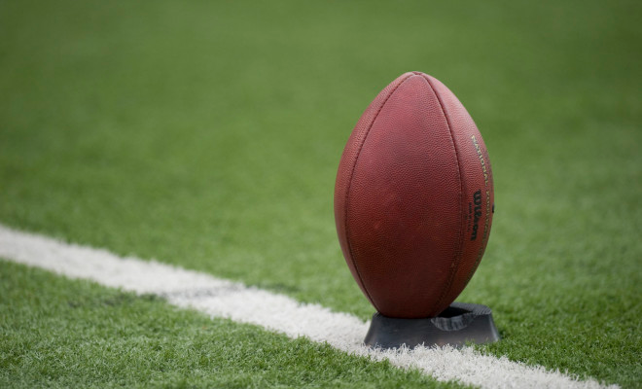
KICKS
Anefo
August 26, 2019
Kevin Chapman

Slide 2
Free Kicks
New Dead Ball Fouls:
No Team K player may be more than 5 yards behind the LOS after RFP unless he kicks
Team K encroaches at the kick (use common sense!)
Fewer than 4 players on either side of the kicker (foul when kicked)
Team K employs a “pop up” kick
MIAA Red Ink Tip: After a try or a field goal, the opponent of the scoring team shall designate which team will kick off.

Slide 3
Free Kicks
Free Kick Out of Bounds:
Team R options:
25-yards from kick (usually the 35yd. line)
5-yards from dead ball spot or previous spot + re-kick
Touchback:
Ball is dead if it breaks plane of Team R’s goal line while still a “kick” by rule
If either team touches/muffs the kick --> Touchback to the 20-yard line
Reminder: the kick ends when R gains possession
Same rule for scrimmage kicks

Slide 4
Free Kicks
Fouls During Free Kicks:
Team K
All fouls may be tacked on so long as Team R is next to put the ball in play (except KCI)
Team R
All fouls must be previous spot and re-kick or first down
If Team R player signals for a fair catch and then blocks, the penalty is enforced from previous spot on a free kick, but PSK on Scrimmage kick

Slide 5
Free & Scrimmage Kicks
Kick Catch Interference:
When a kick is still in flight:
Touching restrictions:
Free Kick: Team K may not catch/touch/bat a ball in flight
Scrimmage Kick: Team K may catch a ball in flight so long as no R in position to catch
Team K may not touch a Team R player
Team K may not obstruct a Team R player’s path to the ball
Does not apply if:
Team R has touched the ball
The ball has hit the ground
Team K player is blocked into the ball or the receiver
Enforcement
Decline; 15yds. from previous and re-kick; or awarded fair catch at spot of foul +15yds.

Slide 6
Scrimmage Kicks
Is the Continuity of Downs Broken?
Depends on where the ball is when first touched
BEYOND the Neutral Zone
BEHIND the Neutral Zone
By R beyond expanded NZ
By K beyond regular NZ
By R behind expanded NZ or
By K behind regular NZ
Continuity Broken
K may recover
K cannot advance if it recovers beyond regular NZ
K may advance, kick, or even pass if it recovers behind NZ after R touches beyond expanded NZ
Continuity Broken
K commits First Touch
Ball is dead when ball comes to rest beyond NZ. (If K touches a ball at rest, the down ends. R cannot advance)
Continuity Not Broken
Either team may recover and advance
If K recovers, it may run, pass, or kick but must get 1st down
Exception: if ball goes OOB while still a kick, belongs to Team R no matter where it went out or who touched it
Exception: simultaneous possession belongs to R (K’s punt is blocked, never crosses NZ, but simultaneously recovered in the K’s EZ is TD!!)

Slide 7
Scrimmage Kicks
Fair Catches
Any Team R player can signal for a FC on a scrimmage or a free kick
NFHS – R isn’t awarded a touchback for FC between 25 and goal line
Valid FC depends on WHAT signal is given and WHEN the signal is made:
Valid Fair Catch:
What: “extending and lateral waving of one arm at full arm’s length above the head”
When: “in or beyond the NZ to the receiver’s goal line while the untouched ball is in flight”
Invalid Fair Catch:
Improper Signal – waving both arms, get away, chest flick, etc.
Any signal (proper or improper) given after ball has touched a receiver
Any signal given after the ball has touched the ground
Illegal Fair Catch Signal:
Any signal given by the runner after catching or recovering the kick
A signal given by any other player after the catch/recovery is ignored
Both Valid or Invalid Fair Catches cause the ball to become dead
An Illegal Fair Catch Signal, however, is a live ball foul (play continues)
Regardless of signal, scrimmage kick recovered by Team K in or behind NZ can be advanced
Invalid or Illegal Fair Catch Signals are 5yd. penalties assessed under all but one principle (common sense)

Slide 8
Scrimmage Kicks
Protection & Blocking
Protection:
Any receiver who gives a valid FC signal is afforded an unmolested opportunity to catch the kick
Protection is lost if the ball is muffed. Receiver is not given chance to complete the catch after a muff
No protection:
Invalid Fair Catch
Non-signaling receiver
Receiver who has signaled but is in no position to make a fair catch
Ball hits the ground or another Team R player beyond LOS
** Still illegal to unnecessarily rough a receiver who is not given protection**
** Receiver still protected against KCI **
Blocking:
Any receiver who gives a valid or invalid FC signal may not block (15yd. even if in the IBB) until kick has ended

Slide 9
Scrimmage Kicks
Miscellaneous Rules
Numbering:
On 1st, 2nd, or 3rd – Four must wear 50-79, Snapper may wear nonconforming
On 4th – All Linemen can have Nonconforming Numbers
In both instances, nonconforming numbered linemen are ineligible even if at the end of the line
Blocks Below the Waist ARE permitted on Punts and PATs:
Same rule as for regular scrimmage downs
Because ball will leave the zone quickly, blocks must be simultaneous w/snap by linemen
who are in 3 and 4 pt. stances in free block zone

Slide 10
Field Goals
Holder must rise before transferring possession by handoff, forward, or backwards pass
A FG operates like a punt:
A FG that crosses Team B’s goal line is dead
If it misses, it’s a touchback
A FG is NOT dead if it lands (and stays) in bounds between the goal lines
Team R can catch in the air and return
Team R can recover it after it hits the ground and return
A ball that comes to rest inbounds untouched by R will belong to R at that spot
Blocked FG remains live
Continuity of downs is same as punts

Slide 11
Free Kick After Fair Catch
Rule: If Team R makes or is awarded FC, it may choose to attempt a free kick for a FG
Conditions:
The FC must be legal
Applies if Team R is awarded a FC as a result of KCI
Teams line up in free kick formation
Kickoff tee may be used
If Team A does not elect to free kick after FC, but Team B commits (a) a dead ball foul prior to the snap, or (b) a live ball foul that results in the down being replayed Team A can elect the free kick after enforcement of the penalty
[Example, Team A makes FC at B-40. They decline option for free kick. On the next play, Team B (a) encroaches (b) commits DPI. Ruling: In both situations, Team A may now elect a field goal attempt by free kick.]

