Slide 1
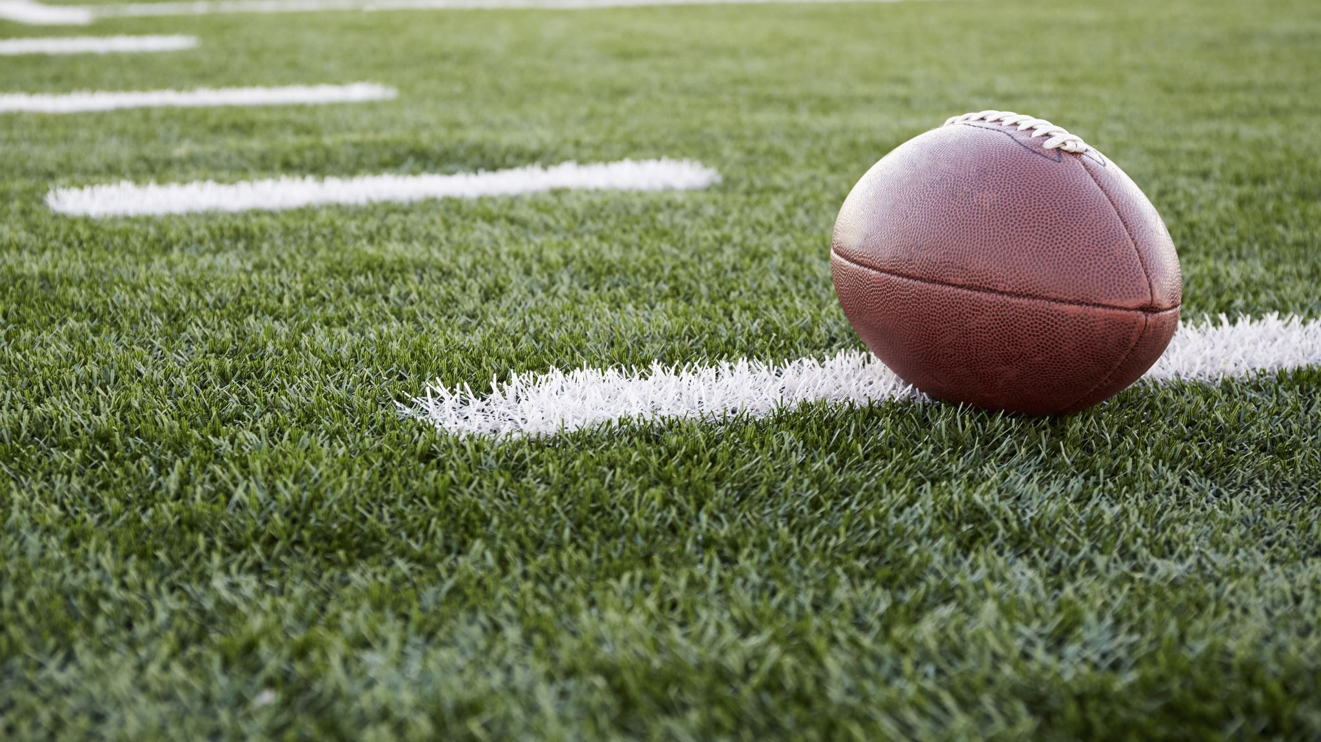
Conduct of players and others
ANEFO Meeting 9/30/2019
By
Eugene Borgonzi

Slide 2
Section 1 – helping the runner
An offensive player shall not PUSH, pull or lift the runner to assist his forward progress
Only difference from NCAA is PUSHING. NCAA did away with pushing a few years ago.

Slide 3
Section 2 – illegal use of hands and holding
An offensive player (except the runner) shall not:
Use a blocking technique which is not permissible by rule
Two permissible techniques (same for the defense):
Closed or Cupped Hand Technique
Open Hand Technique
Refer to definition of blocking in Rule 2-3-2
Grasp or encircle any teammate to form interlocked blocking
Hold an opponent (same for the defense)
The runner may not grasp a teammate
A defensive player shall not:
Use his hands to add momentum to the charge of a teammate who is on the line of scrimmage
Contact an eligible receiver who is no longer a potential blocker

Slide 4
Section 3 – illegal blocking
Blocking below the Waist outside the free blocking zone
Receiver who has given a valid or invalid fair-catch signal
Blocking the kicker or place-kick holder of a free kick before:
He has advanced 5 yards beyond his free-kick line; or
The kick has touched the ground or any other player
Chop block (High-Low) or clip (unlike NCAA clipping is not allowed in the tackle box)
Block in the Back except:
In the free blocking zone
Using hands and arms when attempting to reach the runner or recover a loose ball which he may legally touch/possess

Slide 5
Section 3 – illegal blocking (continued)
No member of the kicking team shall initiate contact to an opponent on a free kick until:
The legal kick has traveled 10 yards
The kicking team is eligible to recover a free-kicked ball; or
The receiving team initiates a block within the neutral zone

Slide 6
Section 4 – illegal personal contact
No fighting
Shall not intentionally contact a game official
No player or nonplayer shall:
Kick, knee, strike or trip an opponent
Charge into or throw an opponent to the ground after he is obviously out of the play or after the ball is clearly dead either in or out of bounds
Pile on any player who is lying on the ground
Hurdle an opponent who has one or both feet on the ground
Position himself on the shoulders or body of a teammate or opponent to gain an advantage
Throw a helmet to trip an opponent

Slide 7
Illegal contact (continued)
No player or nonplayer shall:
Make any other contact with an opponent which is deemed unnecessary or excessive and which incites roughness
Grasp on opponent’s face mask, edge of helmet opening, ear hole, chin strap, or mouthpiece and twist, turn or pull (if you call it’s a 15 yard penalty)
Horse collar an opponent even if possession is lost
Initiate contact with an opposing player whose helmet has come completely off
Target an opponent
Execute a blindside block outside of the free blocking zone with forceful contact unless initiated with open hands

Slide 8
Illegal contact (continued)
Initiate illegal helmet contact
Butt block – act by any player who initiates contact against an opponent who is not a runner with the front of his helmet
Face tackling – act by a defensive player who initiates contact against a runner with the front of his helmet
Spearing – act by any player who initiates contact against an opponent at the shoulders or below with the crown of his helmet
Illegal helmet contact may be judged a flagrant act by official. Examples include:
Contact against opponent on ground
Contact against opponent being held up by other players and/or:
Contact against a defenseless opponent

Slide 9
Illegal contact (continued)
Roughing the passer – Contacting a passer who has thrown the ball from in or behind the neutral zone after it is clear the ball has been thrown.
Running into or roughing the kicker or holder
Run = contact that displaces the kicker or holder without roughing
Roughing = block, tackle or charge into the kicker or holder other than when:
Contact is unavoidable because it’s not reasonably certain that a kick will be made
Defense touches the kick near the kicker and contact is unavoidable
Contact is slight and is partially caused by movement of the kicker
Contact is caused by R being blocked into the kicker/holder by K
Roughing the Snapper – Defense shall not charge directly into the snapper when the offensive team is in a scrimmage kick formation

Slide 10
Illegal contact (continued)
No defensive player may use his hand to slap the blocker’s head
Unintentional contact between a nonplayer and a game official in the restricted area while the ball is live
KEEP EVERYONE OUT OF THE WHITE!!!!!!!!
First offense 15 yards from succeeding spot
Second offense: 15 yards from succeeding spot and disqualification of the head coach
All fouls under this section if deemed flagrant by an official will result in disqualification

Slide 11
Section 5 – noncontact uns by players
Baiting or taunting acts or words or insignia
Profanity, insulting or vulgar language or gestures
Delayed, excessive or prolonged act by which a player attempts to focus attention upon himself
Using disconcerting acts or words prior to the snap in an attempt to interfere with offense’s signals or movements (15 yard unsportmanlike instead of 5 yard delay of game under NCAA)
Kicking at the ball other than during a legal kick or intentionally kick the ball
Refusing to comply with an official’s request
Using alcohol or any form of tobacco products
Spike the ball or throw the ball high into the air or from the field of play or end zone
Intentionally fail to place the ball on the ground or immediately return it to a nearby game official

Slide 12
Section 6 – illegal participation
No player shall intentionally go out of bounds during the down and: (live-ball, basic spot)
Return to the field
Intentionally touch the ball
Influence the play
Otherwise participate
If a player is blocked out of bounds by an opponent and returns to the field during the down, he shall return at the first opportunity.
No replaced player, substitute, coach, athletic trainer or other attendant shall hinder an opponent, touch the ball, influence the play or otherwise participate. (live-ball, basic spot)

Slide 13
Illegal participation (continued)
It is illegal participation:
Any player, replaced player, substitute, coach, athletic trainer or other attendant enters and participates during a down (live-ball, basic spot)
If an injured player is not replaced for at least one down; unless halftime or overtime intermission occurs (live-ball, previous spot)
To have 12 or more players participating at the snap or free kick (live-ball, previous spot)
To use a player, replaced player etc in a substitution or pretended substitution to deceive opponents at or immediately before the snap for free kick (live-ball, previous spot)
For a player to be lying on the ground to deceive opponents at or immediately before the snap or free kick (live-ball, previous spot)
For a disqualified player to re-enter the game (live-ball, previous spot)
For a player whose helmet comes completely off during a down to continue to participate beyond the immediate action he was engaged in. (live-ball, basic spot)

Slide 14
Section 7 – illegal kicking and batting
No player shall intentionally kick the ball other than as a free or scrimmage kick
No player shall bat a loose ball other than a pass or a fumble in flight, or a low scrimmage kick in flight which he is attempting to block in or behind the expanded neutral zone EXCEPTION: A K player may bat toward his own goal line a grounded scrimmage kick or a scrimmage kick in flight which is beyond the neutral zone, if no R player is in position to catch the ball.
Any pass in flight may be batted in any direction, by an eligible receiver unless it is a backward pass batted forward by the passing team
A ball in player possession shall not be batted forward by a player of the team in possession

Slide 15
Section 8 – noncontact uns by nonplayers
Use of profanity, insulting or vulgar language or gestures
Attempting to influence or indicating objections to a decision by an official
Disrespectfully addressing an official
Using any illegal communication equipment
Holding an unauthorized conference
Failure to comply with restrictions of Rule 3-2-2 at the coin toss
Failure to be ready to start the first half
Failure to be on the field following the conclusion of halftime or be ready to start the second half at the conclusion of the mandatory warm up period

Slide 16
Noncontact uns by nonplayers (continued)
Following pre-game verification, A coach allowing his players to use illegal equipment
Being on the field except as a substitute or replaced player
Using alcohol or any form of tobacco product
Being outside the team box, but not on the field (between the 25 yard lines)
A substitute leaving the team box during a fight
A maximum of three coaches may be in the restricted area however no player, nonplayer or coach shall be in the restricted area when the ball is live.

