Slide 1
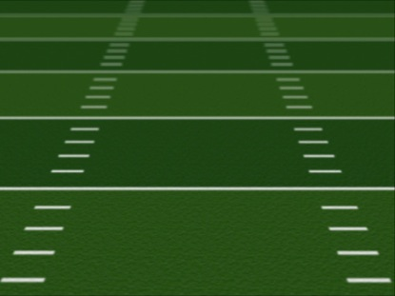
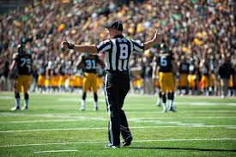
Back Judge
Techniques

Slide 2
Equipment
Whistle
Wristwatch
Bean Bags (2)
Flags
Down Indicator
Coin (as an emergency backup if R does not have one)
Game Card and Pen

Slide 3
Pre Game
Discuss with wing officials coverage responsibilities re: WR’s
Discuss with wing officials when you will give up goal line to them
Check the Pylons and the on field yard markers (usually the yard markers are initially set up directly on the sideline. BJ should move them back which helps to control sideline interference and makes movement by wings easier)
Assist the Linesman with checking the chains
Talk to QBs and Coaches re: mechanics for when the play clock reaches 10 secs and 5 secs
Introduce yourself to persons responsible for game balls and instruct them on procedures for getting the ball in (especially during wet weather)

Slide 4
Positioning
The back judge moves a great deal during a game. Being in position to make the proper call is critical for success.
Be at least 18-20 yards beyond defensive line of scrimmage and always deeper than deepest defensive back
Position no wider than hash marks
Position determined by strength of offensive formation
Balanced formation = strength considered to be on line judge side
Strength can change by man in motion
At snap Retreat Read React
By retreating first, you position yourself well if there is a deep route by a speedy receiver
Read the type of play and where the flow of the play is headed
The reaction is the motion that gets you in the proper position
Do not chase play—”Happy Feet”
When ball becomes dead move in to assist with dead ball officiating
Short yardage play stay back to observe all of the action

Slide 5
Positioning cont.
Try to work from inside out. Middle of the field of play towards the sideline
Keep players boxed in to create different points of focus with wing officials
Always keep play in front of you
Get to goal line quickly and hold your position if there is a possibility of it coming into play
Communicate to wings when you will be giving up goal line and positioning on end line
On a turnover, reverse mechanics come into effect and you are now the trailing official
Field Goals/Extra Points- a few yards back of the upright on the Linesman’s side
Punts-position slightly behind and to the side of the deepest receiver on the linesman’s side
On kicks from inside the receiving team’s 40 yard line, take a position on the goal line at the sideline.
Kickoffs-back deep with Referee on opposite sideline (some R’s may elect to have BJ be up to hand ball to kicker)

Slide 6
Game Play
Among other things, a back judge rules on pass interference, illegal blocks downfield and incomplete passes.
Back judge will cover the area of the field in between themselves and the umpire. Covering from sideline to sideline.
Pre-snap:
All defensive players should be in front of you
Count the defense on EVERY PLAY (start with the offensive sideline and work your way back)
Verify count with wing officials
Know what receivers are your keys
Be consistent with your play clock signals
The back judge is responsible for ruling a "delay of game" infraction if the play clock expires.
Give clear “Arm up” at 10 seconds and “Arm Straight” at 5 seconds
Back judge with the assistance of the line judge rules whether field goal and extra point attempts are successful and is responsible for the whistle.
On measurements back judge is responsible for kneeling down and holding ball in place

Slide 7
Game Play CONT.
When there is some potential ambiguity, the BJ should confer with the wings and/or umpire before ruling on a play.
This could be accomplished simply by making eye contact with another official to either confirm or disagree with a ruling.
The back judge can also help verify that the game clock is properly starting and stopping.
Will also time the time outs and notify R when 15 secs remain
Punts:
COUNT TEAM B and then COUNT them again
Remind yourself what to look for—a fair catch signal, first touching, kick catch interference, legal or illegal batting and touchbacks
Carry bean bag in hand during down to mark first touching
Be on lineman’s side of field keep the play between two officials
Remind punt receiver each and every time that if he wants to make a fair catch, give a good signal and not make any other motions with hands (i.e. shielding eyes from sun)
Back judge should always be hustling, though don’t over hustle (especially on short runs) as teams often run no huddle, hurry up offenses and you need to be back in position
The back judge is often the official that can make the rest of the crew look good (or not) Be in the right position and call the play as you see it.

