Slide 1
ANEFO RULE 10: PENALTY ENFORCEMENT October 16, 2023

Slide 2
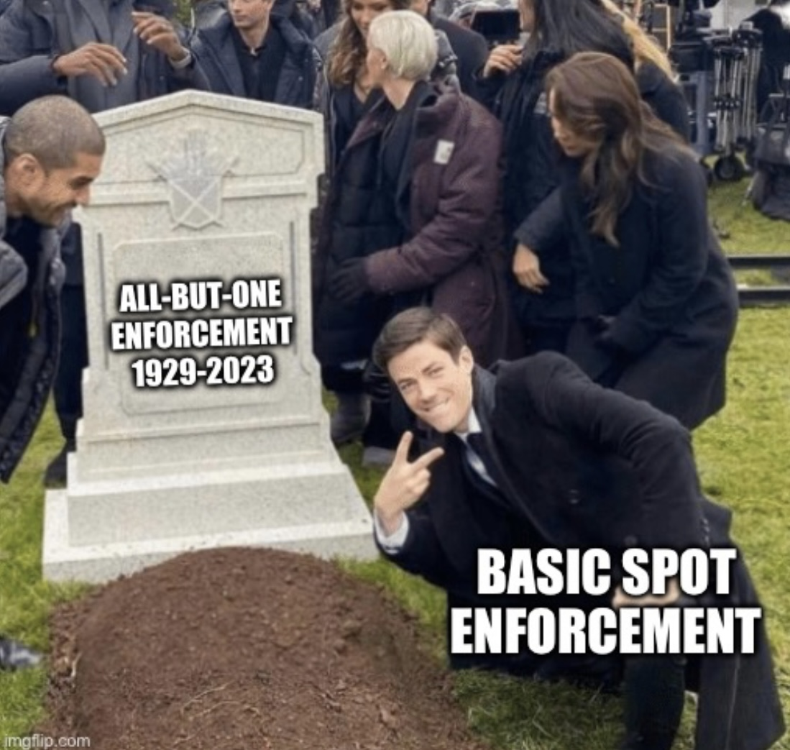
PENALTY ENFORCEMENT OVERVIEW
THE MAIN PROCESS REQUIRES TWO STEPS:
1. Determine the Type of Play (loose ball play or running play)
2. Determine the Basic Spot….and now in 2023, unless there is a special enforcement, THE BASIC SPOT IS THE ENFORCEMENT SPOT

Slide 3
1. TYPE OF PLAY: THERE ARE TWO TYPES… LOOSE BALL PLAY & RUNNING PLAY
A LOOSE BALL PLAY is action during:
A free kick or scrimmage kick
A legal forward pass
A backward pass (including the snap), illegal kick, or fumble made by Team A from in or behind the neutral zone prior to a change of team possession
The run or runs which PRECEDE any of the above
Examples….

Slide 5
LOOSE BALL PLAY FUMBLE BEHIND NZ

Slide 6
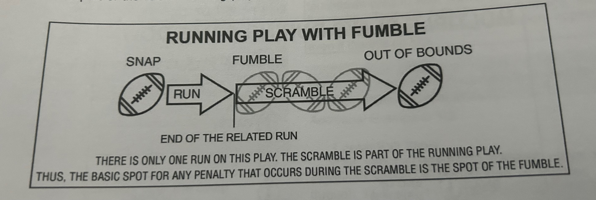
TYPE OF PLAY: THERE ARE TWO TYPES… LOOSE BALL PLAY & RUNNING PLAY
A RUNNING PLAY is all live ball action that ISN’T a loose ball play.

Slide 7
2. DETERMINING THE BASIC SPOT / ENFORCEMENT SPOT The basic spot is determined by:
STEP 1, TYPES OF PLAYS. STEP 2…..
Type of play
Location of foul
Where the related run ended
Which team fouled
It’s still important to be sure of these four things when reporting fouls and enforcing penalties!

Slide 8
UNLESS THERE’S SPECIAL ENFORCMENT, THE BASIC SPOT IS THE ENFORCEMENT SPOT. 5 possible basic spots:
The spot of the foul
The end of the run
The previous spot
The post-scrimmage kick spot
The succeeding spot

Slide 9
TYPE OF PLAY BASIC SPOT TYPE OF PLAY/LIVE BALL FOUL BASIC SPOT Foul Simultaneous with Snap Previous Spot Loose Ball Play Previous Spot Running Play Team A Foul (no change of possession) If Foul Behind Neutral Zone Previous Spot If Run Ends Behind Neutral Zone Previous Spot If Foul AND End of Run Beyond NZ Old All But One* Running Play Team B Foul (no change of possession) If Run Ends Behind NZ Previous Spot If Run Ends Beyond NZ Succeeding Spot/End of Related Run

Slide 10
TYPES OF PLAYS… Play 1: 1/10, midfield. While rushing the QB, B99 twists A77’s facemask. A11 eludes the rush, rolls out, and completes a pass to A88, who is tackled at the B-20. Play 2: 2/G, B-10. On a sweep play, A33 fumbles near the sideline at the B-5. While the ball is loose, B44 blocks A88 below the waist in the endzone. The ball hits the pylon. What type of play did the foul occur during?

Slide 11
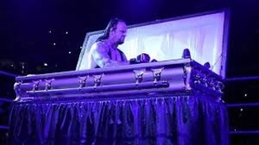
TYPES OF PLAYS… Play 3: 1/10, midfield. A1 runs to the B-30. A88 holds at the B-25. Play 4: 1/10, midfield. A1 runs to the B-30. A88 holds at the B-35. Team A foul when the run ends beyond NZ and the foul occurs beyond NZ…. the return of the old All-But-One principle d

Slide 12
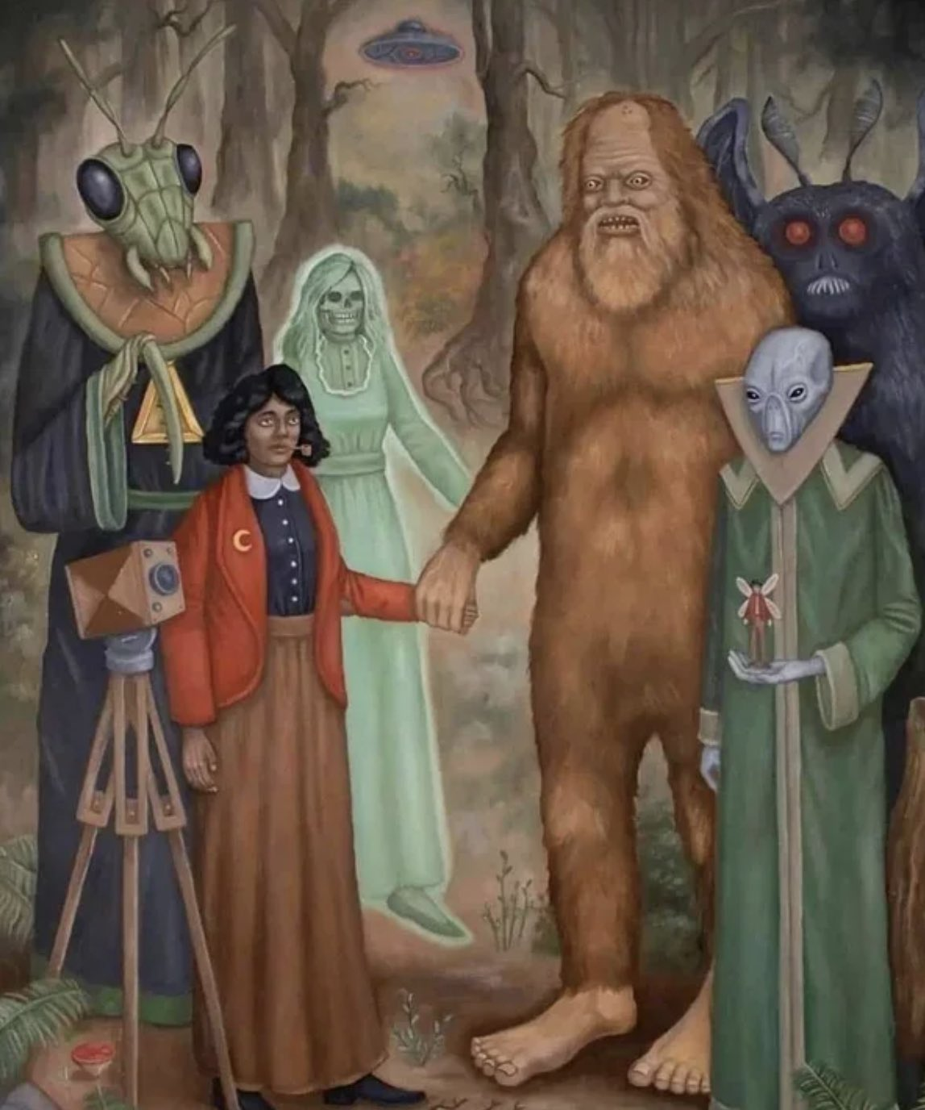
WEIRD FOULS AND THE SPOTS WHO LOVE THEM
When the lights come on in the club
FOULS BY TEAM A
IN THEIR ENDZONE (SAFETY)
ILLEGAL FORWARD PASS
ILLEGAL BATTING & KICKING
For these fouls, the basic spot is the SPOT OF THE FOUL!
ILLEGAL PARTICIPATION 9-6-4A ; 9-6-4G

Slide 13
POST SCRIMMAGE KICK ENFORCEMENT
5 ELEMENTS REQUIRED. THE FOUL MUST OCCUR:
During scrimmage kick plays, other than a try or a good FG
During a scrimmage kick play in which the ball crosses the expanded neutral zone
Foul occurs beyond the expanded neutral zone
Foul occurs before the end of the kick
And K will not be next to put the ball in play
Note: This is why we need a bag at the end of the kick. And for a touch by Team K. Not for a muff by Team R

Slide 14
SPECIAL ENFORCEMENTS
Free kick out of bounds untouched by R (wing officials on kickoff should know the options to give to coaches)
Kick catch interference (15 from spot of foul; 15+ awarded fair catch; or 15 from previous)
Unfair acts (major referee discretion)
A foul by the non-scoring team on successful try or FG (kickoff or OT)
Fouls that occur during or after a touchdown scoring play (try or kickoff; not carry into OT. It specifies try or succeeding kickoff. NOT succeeding)
Roughing the passer/snapper/kicker/holder
Fouls by K during a free or scrimmage kick down prior to the end of the legal kick (except KCI)

Slide 15
Roughing the passer*
Roughing the kicker
Roughing the snapper
Roughing the holder
*tack on to dead ball spot if no change of possession
Intentional grounding
Illegal forward pass
Illegal forward handoff
Illegal touching by ineligible
AUTOMATIC FIRST DOWNS
LOSS OF DOWN

Slide 16
LIVE BALL – DEAD BALL FOULS
Live balls never offset dead ball fouls
Dead ball fouls enforced separately and in order of occurence
Dead ball 15 yard penalties and live ball fouls treated as dead ball fouls cancel if they’re equal number. (3 on A and 1 on B? Enforce 2 penalties on A)
Unsportsmanlike fouls and bench/sideline interference fouls enforce as dead ball
CHANGE OF POSSESSION: “CLEAN HANDS”
If there’s a change of possession during the down and the team that winds up with the football did not foul before they gained FINAL possession, they may keep the ball by declining their opponent’s fouls.

Slide 17
Free kick at the K-40. While kick is in flight, R99 holds K4 at the R-40. R1 fields the kick at the R-10 and gets tackled at the R-35.
1/10, A-20. Team A has 5 men in backfield. A11’s pass is intercepted by B22 at the A-30. During the return, B44 blocks below the waist at the A-5. After B22 crosses the goal line, he’s thrown to the ground by A11.
4/10 @ K-20. While punt is in flight, R88 holds K11 at the K-30. R22 fields the punt at the K-40 and returns it to the K-15 where he is tackled by the facemask by K99.
Team K’s punt is rolling towards Team R’s goal line. K1 is trying to down the punt. R66 holds K1 at the R-8 before the ball crosses the goal line.

Slide 18
GENERAL SUGGESTIONS
It’s the entire crew’s responsibility to get enforcement right. Not just the referee.
We are a team out there. If you think something is about to be enforced incorrectly, speak up. (And referees, be humble and receptive to potential crew-saving input ☺)
Yes we want to keep the flow of the game moving, but we don’t want to rush enforcements. ESPECIALLY when they involve something out of the ordinary. Take your time.
Explain unusual situations to coaches. Have another official present.

