Slide 1
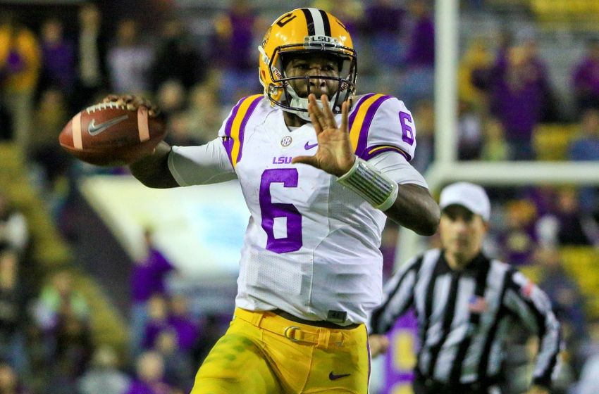
Rule 7: Passing & Snapping

Slide 2
The Scrimmage
No Team A player shall simulate the start of the play including making any quick, jerky movements
All Team A players and incoming subs must have been between the numbers after the previous down and before the start of the next
Once the snapper is established no Team A player may be in or beyond the neutral zone
WHISTLE, FLAG, 5 YARDS

Slide 3
Pre-Snap Team Requirements
OFFENSE
Five linemen - #50-79
Numbering exception on scrimmage kick
No more than 4 players set as backs
One back in motion
Not towards opponent's goal line
Set for one second after shift
Cannot start from line
FLAG, 5 YARDS
DEFENSE
Cannot touch the ball
Cannot touch opponent
Cannot enter the neutral zone and cause adjacent opponent to react
Cannot cross the neutral zone and continue charge to any Team A back
No abnormal movements or sounds
WHISTLE, FLAG, 5 YARDS

Slide 4
Hand Off/Backward Pass
Ball can be handed forward when both players are behind the line of scrimmage*
A back may hand the ball forward to a teammate originally on the scrimmage line if he leaves the line faces his end line (feet must point to his end line) and is 2 yards behind the line of scrimmage*
Fumble remains live for all players
Fumble on 4th down can only be advanced by the fumbler or Team B player
Fumble returns to spot of fumble if out of bounds in advance of spot
Fumble stays at out of bounds spot if out of bounds behind the spot
Simultaneous recovery belongs to team last in possession
Ball carrier may hand or pass the ball backwards at anytime except out of bounds to conserve time*
Backward pass live for all players
Simultaneous recovery belongs to team last in possession
Backward pass out of bounds stays with passing team at out of bounds spot
*FLAG, 5 YARDS, LOSS OF DOWN IF BY TEAM A PRIOR TO TEAM POSSESSION CHANGE

Slide 5
Illegal Forward Pass
Passer’s entire body is beyond the neutral zone when ball is released
Pass thrown by a Team B player
Pass thrown after team possession
Second forward pass thrown by Team A
FLAG, 5 YARDS, LOSS OF DOWN IF BY TEAM A PRIOR TO TEAM POSSESSION CHANGE
Passer spikes the ball directly to the ground after it has touched the ground
Passer spikes the ball but not immediately
Passer, who has never been outside the tackle box, throws where there is no eligible Team A player
FLAG, LOSS OF DOWN AT SPOT OF FOUL

Slide 6
Pass Catchers Eligibility
ELIGIBLE PASS CATCHERS
Lineman on the end of the line not numbered 50 – 79 and Backs
All Team B players
All players after ball is touched by Team B player or an official
INELIGIBLE PASS CATCHERS
Lineman numbered 50 – 79
(Originally ineligible receivers are also forbidden from being 3 yards beyond the neutral zone prior to pass crossing the line)
FLAG, 5 YARDS
Eligible receiver who goes out of bounds
Exception: Forced out by a Team B player and returns to the field of play immediately
FLAG, LOSS OF DOWN

Slide 7
Pass Interference
Offensive Pass Interference
Contact that interferes with a Team B eligible player when a legal forward pass crosses the neutral zone
It is the responsibility of the offensive player to avoid his opponents
Exception:
Team A initiates a block within a yard of the neutral zone and maintains contact no further than 3 yards beyond
2 or more players make a bona fide attempt to reach the pass
FLAG, 15 YARDS
Defensive Pass Interference
Contact beyond the neutral zone with intent to impede a Team A player, who is position to receive a catchable pass, after a legal pass crosses the neutral zone
Exception:
Opposing players initiate contact within a yard of the neutral zone
2 or more players make a bona fide attempt to reach the pass
FLAG, 15 YARDS OR SPOT IF LESS THAN 15 YARDS, AUTOMATIC 1st DOWN

