Slide 1
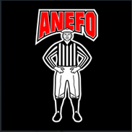
Rule 5:
Series of Downs, Number of Down and Team Possessions After Penalty
ANEFO Sept. 18, 2023 Kevin Chapman

Slide 2
Fouls in Between a Series
Most Common Rule 5 Mistake!!!
General Rule – We should not start a series with 1 and >10
Unless either team commits a foul AFTER the ready for play.
Ready for play = The ball is spotted and the spotting official moves away or RFP whistle
Team A dead ball fouls are enforced, but it’s 1 & 10 to follow!
Example:
3rd and short. Runner A25 runs for the first down. After he is tackled, (a) he makes a throat-slash signal; (b) his teammate pulls the tackler off of the pile. Ruling: In both instances, Team A is awarded 1&10 after enforcement of the 15-yard penalty.
Team A live ball treated as dead result in the same:
Examples:
Unsportsmanlike fouls
Any nonplayer fouls (e.g. sideline interference)

Slide 3
New Series After a Blocked Kick
Applies when Team K kicks on 1st, 2nd, or 3rd down.
Key is whether either team has touched the ball beyond the expanded NZ
If either team touches the ball >2yds beyond the LOS, the next down will be First Down for the team that is in possession at the end of the down.
If neither team touches beyond NZ, and it is recovered by:
Team K will keep the ball for the next down (clock does not stop)
Team R will take possession and get a new series of downs (clock on snap)

Slide 4
Correcting Down Mistakes
Down/Distance can be corrected so long as it is done:
Prior to the ball being legally snapped for a new series, or
Prior to the declaration of the end of the period
Examples:
Team A is given a fifth down and advances for a first down. This can be corrected so long as the ball isn’t snapped to start the next series
The chains set up for an incorrect 1 and 15. This can only be changed before the 1st down snap
Personal Fouls & Unsportsmanlike fouls on extra downs are enforced … others are not.

Slide 5
Rule 6:
Kicking the Ball and Fair Catch
ANEFO Sept. 18, 2023

Slide 6
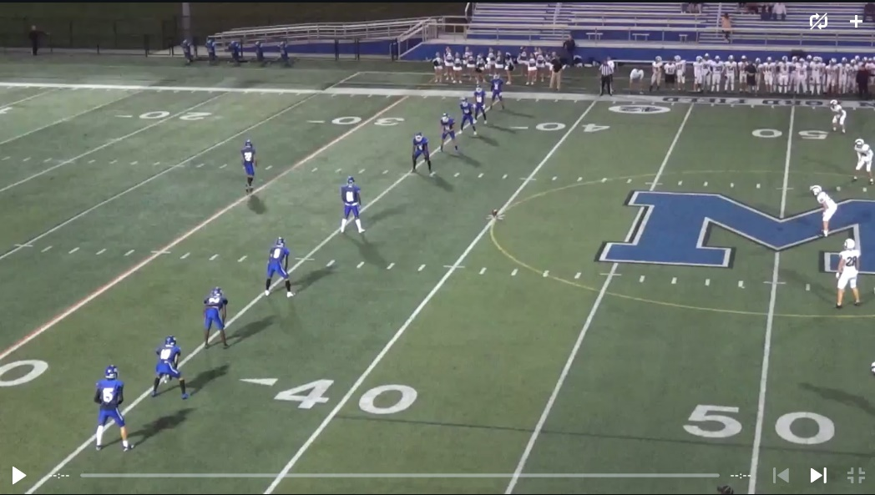
Fouls on Free Kicks
Formation Fouls
Team K not completely within 5 yards of its restraining line (completely inside the white)

Slide 7
Fouls on the kick
Neither team can encroach (dead ball)
Team K needs at least 4 player on each side of the
kicker (dead ball)
No popup kicks (dead ball)
Definition: Immediately driven into the ground
strikes the ground once and goes airborne
as if kicked off of a tee. (dead ball)

Slide 8
Cannot kick the ball out of bounds
Not a foul if R touches
Be careful – even if the ball goes >10 yards, if it goes OOB
untouched by R, it’s still a foul!
Enforcement options
Key yard line is the R-35

Slide 9
Free Kick Coverage Fouls by Team K
Step OOB (live ball illegal participation)
Touch a free kick while still in the air (KCI)
Obstruct a receiver’s path to the ball (KCI)
Contact a receiver in position to catch (KCI)
Block until they can legally touch (illegal block, 10yds.)

Slide 10
Free Kick Coverage Fouls by Team R
Contact the Kicker until:
Kicker has gone 5yds upfield; or
Ball has touched the ground; or
Ball has touched another player
(n.b. these are live ball fouls enforced from
previous spot)

Slide 11
Free Kick Penalty Enforcement Common Live Ball Fouls
Team K fouls are either subsequent spot (“tack on”) or
previous spot and replay
Team R fouls generally are enforced from the
previous spot (no PSK)
Exceptions -
If the foul has special enforcement

Slide 12
Onside Kicks

Slide 13
Things to consider:
Is K in the correct formation?
Did K (or R) encroach?
Is the kick a popup kick?
Did K touch the ball before it could legally possess? (beanbag not flag!)
Did K block before it could legally possess?

Slide 14
Examples
https://youtu.be/lB-VMcCnCDA
https://youtu.be/nm_sXsLSJxU

Slide 15
Fouls on Scrimmage Kicks/Tries
Presnap:
Team K must be properly numbered
Fourth Down or Try → Numbering exception
1st, 2nd, 3rd only the snapper can be misnumbered, if
Field goal formation, and
At least 4 other linemen are properly numbered
Live ball, illegal numbering, 5yd.

Slide 16
Team R can line up directly opposite of
the center, but cannot “charge directly” into
him.

Slide 17
Fouls during a scrimmage kick down
Team K Restrictions:
Can’t rough the snapper, holder, kicker
Can’t run into the kicker (must be previous spot)
Can’t step out of bounds (live ball foul)
Can’t bat a kick unless it’s a backwards bat of a grounded kick
Can’t hit a player who has given a valid fair catch signal and
who hasn’t yet muffed the catch. (NCAA difference)

Slide 18
Team R Restrictions:
Can’t give an invalid signal (5yd. PSK)
Can’t give an illegal signal (5yd live)
Can’t bat in any direction (10yd live
Any player who has signaled for FC cannot block (15yd live)
Any player who has signaled and caught the ball can’t delay the game. (5yd.)

Slide 19
Scrimmage Kick Penalty Enforcement
Team K
Previous spot and replay or subsequent spot for most fouls
Team R
PSK Requirements:
Who? Committed by R and R will next put the ball in play
When? Before the kick ended (not a try or successful FG)
Where? Beyond the expanded NZ
(penalty enforced from the end of the kick – beanbag)
All others are previous spot unless special enforcement

Slide 20
Kicking Potpourri

Slide 21
A missed FG is a treated as a punt.
Teams are allowed a brief timeout after a try to set up the ensuing
kick/return!!!
When the offense scores, it has to kick PAT with the same ball.
When a free kick goes OOB, it’s spotted at the inbounds hash.
Fake FG/Try are OK. Snapper has to lift off the ground to throw.
Fouls by Team B on a scoring play (FG, TD or successful try) can be carried over.

Slide 22
The Big Finale
Two Examples of Excellent Officiating From Week 2

