Slide 1
WELCOME TO THE 2017 SEASON

Slide 2
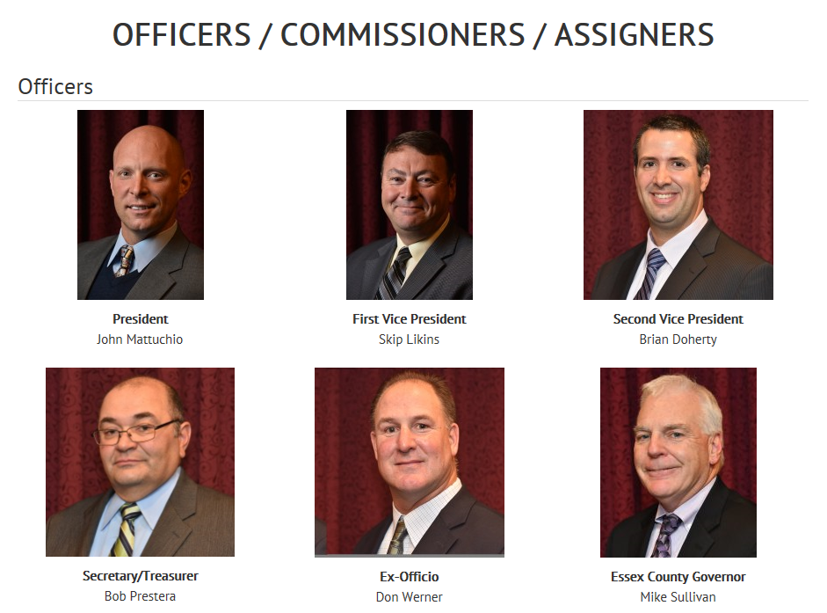

Slide 3
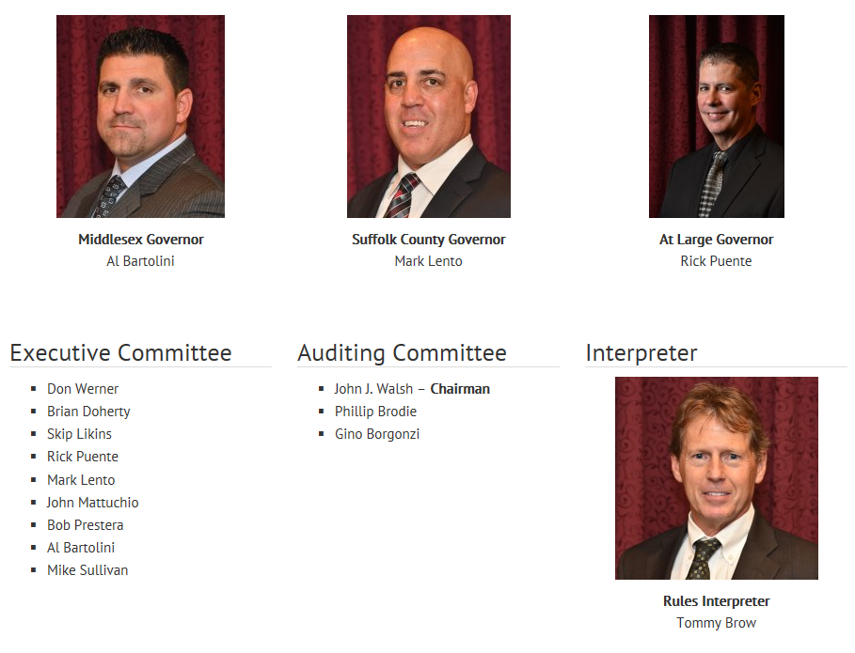

Slide 4
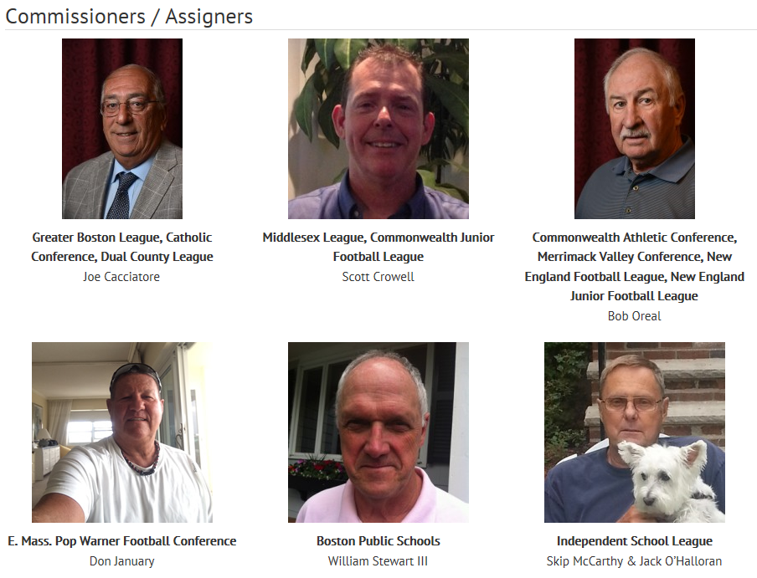

Slide 5
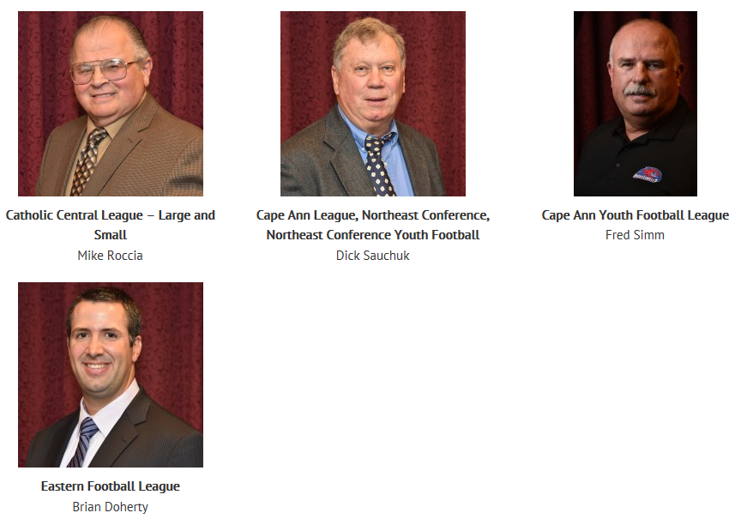

Slide 6
MEMBERS SECTION OF www.anefo.org SITE / WHERE TO FIND PRE-SEASON EXAM
Keep profile updated with correct address and contact information.
Is everyone getting the distribution e-mails? If not, please contact Tommy Brow.
Request for action photos for the home page “slider” (new or old).

Slide 7
EASY TO MAKE PAYMENTS, TAKE EXAM, AND TRACK MEETINGS

Slide 8
MEMBER IN GOOD STANDING CRITERIA
Pay your $75 ANEFO dues by September 5th.
Take the pre-season exam. (Try to make it a group activity to get in the rule book together with fellow officials).
Attendance at six (6) meetings for a member who is solely a high school official is mandatory. College officials are exempt for 2017.

Slide 9
EXCEPTIONS
Members must notify the Secretary / Treasurer in writing if he / she cannot make the mandatory number of meetings.
The banquet does NOT count toward satisfying the meeting attendance requirement.
The first meeting will count as a double meeting if a member (1) is in attendance; and (2) pays his / her dues.

Slide 10
CONGRATS TO CLASS OF 2016! More info in near future regarding Technique Clinic and Controlled Scrimmage requirements.
Joe Beauregard Gerry Bilodeau Shane Bourassa
Kevin Breen Mark Bruso Barry Conroy
Mike D'Angelo Neville DePass Dave Galeazzi
Richard Iozza Judah Jackson Jay Johnson
Steven Kupiec Keith LeBrun, Sr. Reggie Maidment
Paul McCabe Patrick McMenimen Kevin Mulvey
Alan Neves Johnathan Nascimento Scott Owens
Steven Pedersen Fred Rheault Robbie Scioli
John Sciuto Brandan Shaw Corey Turner
Edwin Veira Christian White

Slide 11
MIAA BACKGROUND CHECK REQUIREMENT
https://miaa.arbitersports.com/front/110185/Site
Registration for 2017 / 2018 season starts July 1st.

Slide 13
NFHS CONCUSSION COURSE REQUIREMENT
https://nfhslearn.com/courses/61064/concussion-in-sports
It is suggested to print out annual certification document and keep with you when you are officiating (bag or car).

Slide 14
INAUGURAL ANEFO MENTORSHIP PROGRAM
This is a voluntary and non-mandatory program meant to help those in our association who feel that they need the guidance for getting better at rules interpretation, on-field mechanics, or simply navigating the sometimes intimidating and complex system of getting game assignments. This program is comprised of respected, veteran officials who are willing to serve our association by giving guidance and leading by example both on and off the field. This could include shadowing on chain assignments, sitting in on Varsity pre-game preparation, or even participating in taking the pre-season exam with other veteran officials. Mentors could serve in this capacity for as many as 3 new or junior officials. Any executive board member can also serve in a mentor capacity. Each mentor will have a term of one year and will be determined by the ANEFO executive board annually.

Slide 15
2017 MENTORS
Steve Alvino Ron Annand Joe Cronin
Don Dabenigno Joe Donovan Mark Driscoll
Ed Dubish Dan Foreman Al Guido
Mike Hegan Tim Hooton Phil Howshan
Martine Jones Jim Kearney Bill Lowd
Craig MacDonnell Steve Mulvey Dave Pinciaro
Mike Quinn Mike Roccia John Salmon
Kurt Sinclair Steve Ultrino Steve Szettella
Paul White Steve White
**In addition, all executive board members**

Slide 16
GENERAL ANNOUNCEMENTS
Behavior on social media, please be stewards of our association and respect fellow officials as well as mindful of the repercussions that our comments may have in the press or media outlets.
2” striped shirts…..NCAA has been using for a few years as well as several other neighboring state boards and increasing number of fellow MA chapters. MIAA will allow whole crews to use if all possess for playoff games. Making mention in the event that this becomes mandatory in near future, particularly for the new officials who may make bulk purchases. Similar to black pants when they were phased in about 10 years ago.

Slide 17
GENERAL ANNOUNCEMENTS
http://www.anefo.org/anefo-swag-for-sale (update: Brian Doherty)
All-Sports East will have apparel tent set up out front at first Fall meeting on August 28th.

Slide 18
GENERAL ANNOUNCEMENTS
Upcoming BEYOND ANEFO section of ANEFO site (update: Al Bartolini)
2017 MIAA rule(s) changes (update: Tommy Brow)

