Slide 1
MAJOR FOULS ANEFO PRESENTATION
Gary Donahue
OCTOBER 4, 2016

Slide 2
Blocking Below the Waist Offense
 | Towards original position of the ball | Backwards towards own goalline | 10/2 from the front
Oline inside Box | X | X | X
Oline outside Box |  |  | X
Backs inside Box | X | X | X
Anyone outside Box |  |  | X
Ball Outside Box everyone |  |  | X
Ball Clearly past Neutral Zone | X |  | X
Defense | With in 5yds | yes
 | Against runner | Yes | Anywhere
 | Backward pass | No
 | Eligible receiver | No

Slide 3
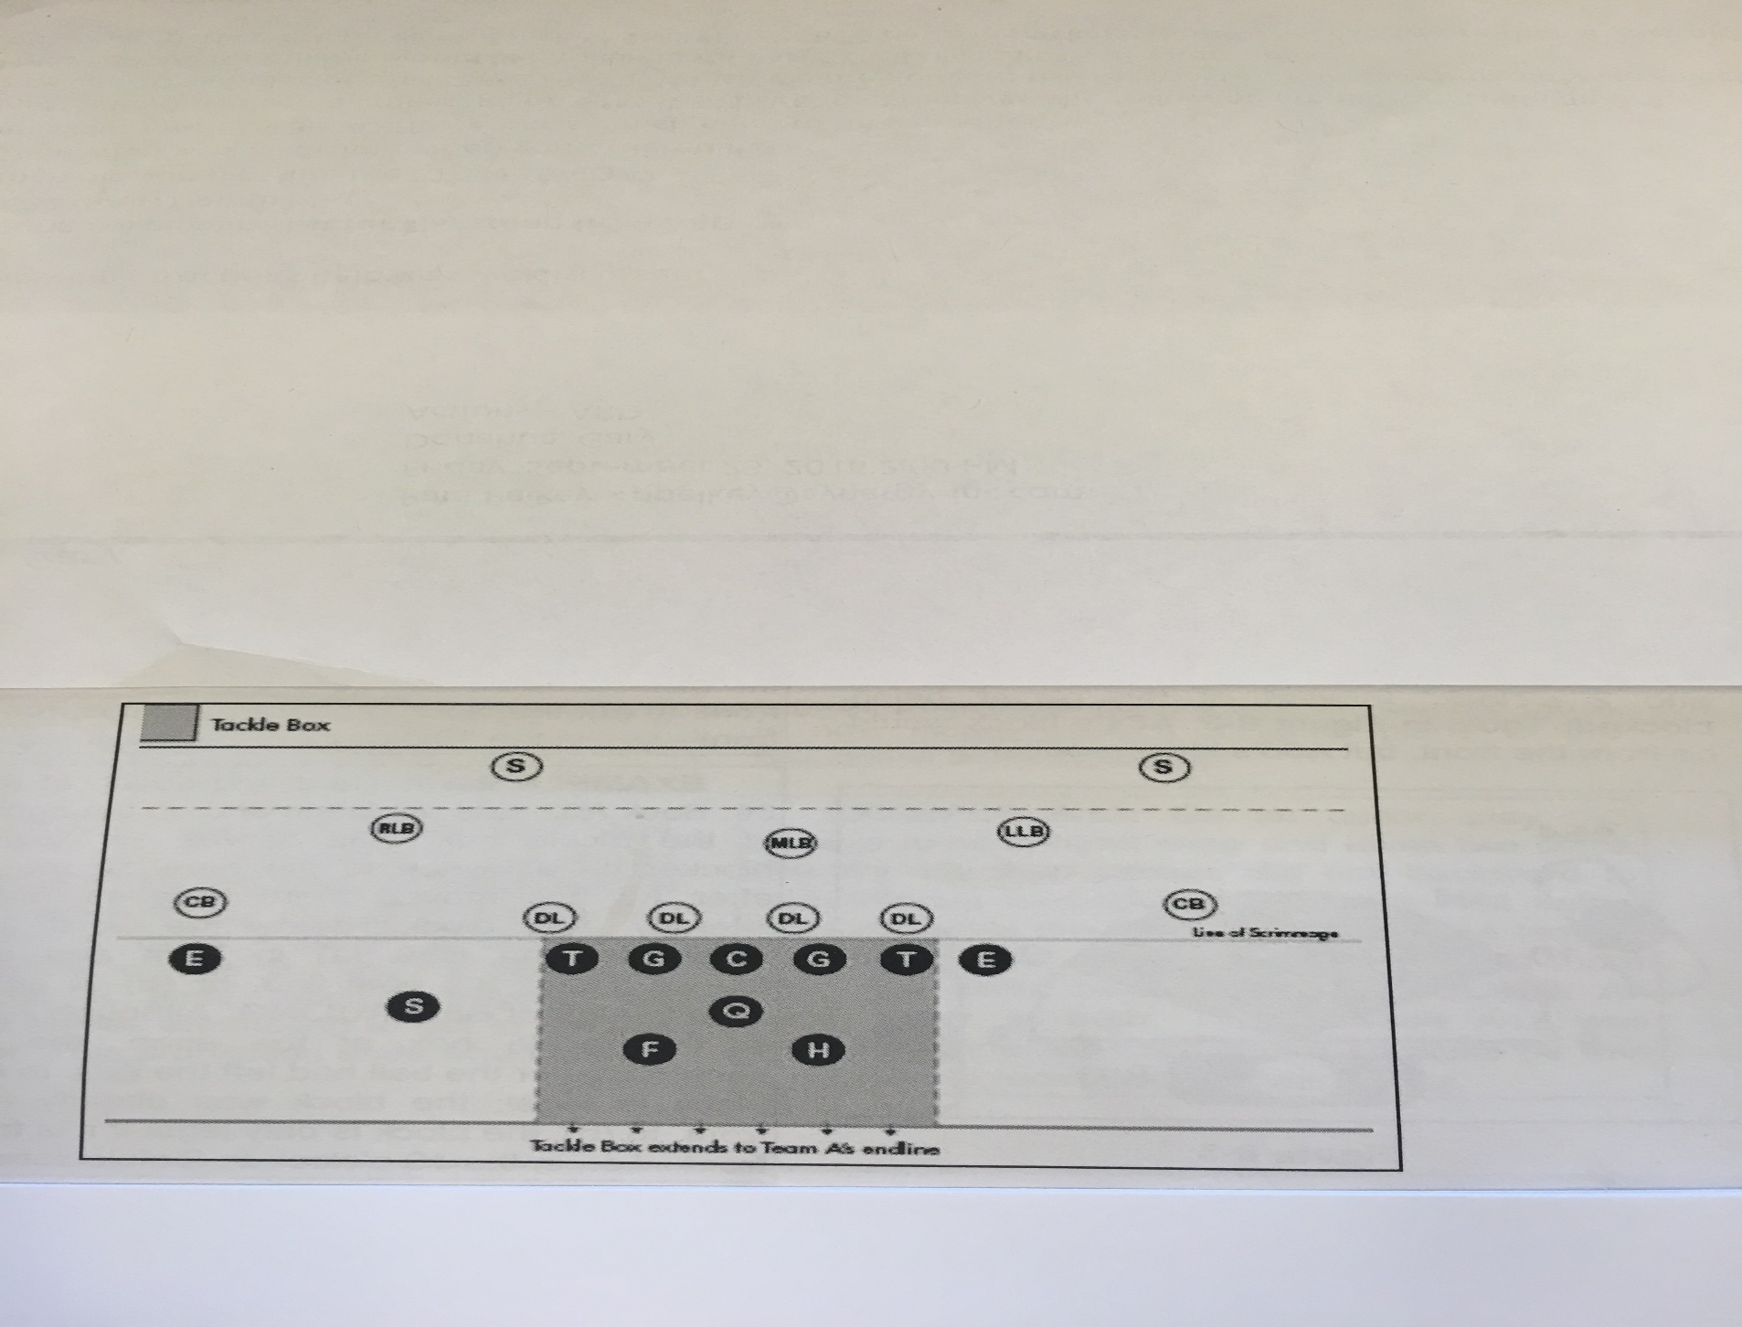
Tackle Box

Slide 4
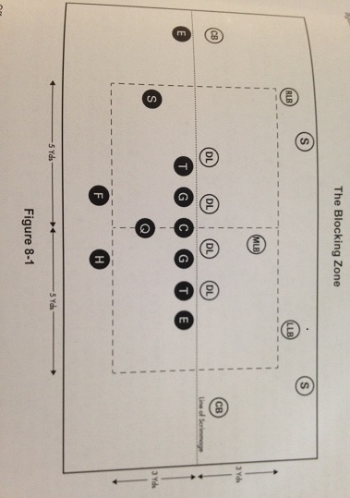
Blocking zone for legal clipping. 5x3

Slide 5
Major Fouls
Clipping | Legal for lineman inside the Blocking Zone 5x3 | Not at or below the knee. No backs
Chop Block | High/low, low/high, | With or without delay
Contact on the snapper | Obvious kicking formation | Player 7 or more yards behind los. A kick does not need to occur
Running into/rough kicker | Protection ends…. | Outside tackle box, Balance
Horse Collar | D pulls from INSIDE back or side of the shirt and collar. Must be immediately pulled down. | Not if in Tackle Box. Not if BC continues to run. Not from the front. Not if back of on outside of the (shirt).
Leverage/Leaping/Landing | Cannot run/jump from behind neutral zone and land on player. Cant leap over player. | Not a foul if doesn’t land on player. Same if “O” initiates contact.

Slide 6
Major Fouls
Holding |  | Did it impact the play?
Targeting | Head/Neck area forearm/shoulder | Disqualification….talk as a crew
Tripping |  | Nobody
Facemask | Pulling/Twisting/Turning | Not a touch or grasp
Player participates with helmet off
Roughing Passer | Unabated at or below knee Role/lunge | Not if blocked into/conventional tackle
Kick Catch interference | 1 yard protection in front | Must be allowed freedom to catch kick regardless of 1 yard rule

Slide 7
Major Fouls
Batting a pass | Forward pass (eligible) | Either team, any direction
 | Backward pass | O can’t bat forward
Batting loose ball | Offense | Not forward
 | In Endzone | Neither team
Kicking a loose ball |  | Neither team

Slide 8
RECOMMENDED RESOURCES
http://romgilbert.us/
(videos, quizzes, discussion topics, etc.)
The Redding Study Guide to NCAA Football Rules--expands on the rule book with explanations, play descriptions, philosophies, etc.
Discuss plays with fellow officials throughout the season (great way to kill time at work)

