Slide 1
ANEFO PRESENTATION RULE 9 MAJOR FOULS
Rich Harrington & Craig McDonnell
October 16, 2007

Slide 2
TARGETING: TWO WAYS
FIRST DEFINITION
Targeting and Making Forcible Contact With the Crown of the Helmet
No player shall target and make forcible contact against an opponent with the crown (top) of his helmet. This foul requires that there be at least one indicator of targeting (See Note 1 below). When in question, it is a foul.

Slide 3
TARGETING: TWO WAYS
SECOND DEFINITION
Targeting and Making Forcible Contact to Head or Neck Area of a Defenseless Player
No player shall target and make forcible contact to the head or neck area of a defenseless opponent (See Note 2 below) with the helmet, forearm, hand, fist, elbow or shoulder. This foul requires that there be at least one indicator of targeting (See Note 1 below). When in question, it is a foul

Slide 4
TARGETING NOTE 1
Some indicators of targeting include but are not limited to:
• Launch—a player leaving his feet to attack an opponent by an upward and forward thrust of the body to make forcible contact in the head or neck area
• A crouch followed by an upward and forward thrust to attack with forcible contact at the head or neck area, even though one or both feet are still on the ground
• Leading with helmet, shoulder, forearm, fist, hand or elbow to attack with forcible contact at the head or neck area
• Lowering the head before attacking by initiating forcible contact with the crown of the helmet

Slide 5
TARGETING NOTE 2
DEFENSELESS PLAYER:
• A player in the act of or just after throwing a pass.
• A receiver attempting to catch a forward pass or in position to receive a backward pass, or one who has completed a catch and has not had time to protect himself or has not clearly become a ball carrier.
• A kicker in the act of or just after kicking a ball, or during the kick or the return.
• A kick returner attempting to catch or recover a kick, or one who has completed a catch or recovery and has not had time to protect himself or has not clearly become a ball carrier.
• A player on the ground.
• A player obviously out of the play.
• A player who receives a blind-side block.
• A ball carrier already in the grasp of an opponent and whose forward progress has been stopped.
• A quarterback any time after a change of possession
• A ball carrier who has obviously given himself up and is sliding feet-first

Slide 6
A88 leaps straight up with arms outstretched in an attempt to catch a pass. As he comes down (with our without the ball), B33 contacts A88 by:
A. Driving his shoulder into A88’s back
B. Driving his forearm into A88’s helmet facemask
C. Driving the top of his helmet into the small of A88’s back
D. Running “heads-up” into A88, so that B33’s facemask hits A88’s ribs
Which of these meet the targeting standard?

Slide 7
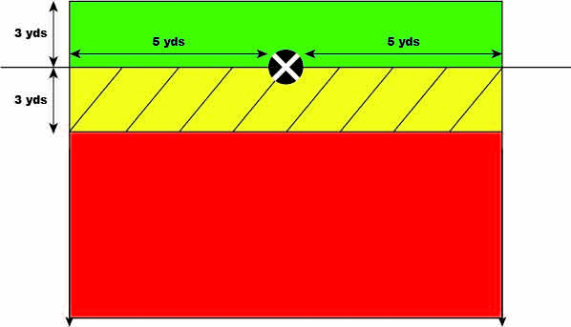
KNOW YOUR BLOCKING ZONES
LOW BLOCKING ZONE
(green & yellow)
TACKLE
BOX
(yellow & red)

Slide 8
Who can do what & where?
BLOCK BELOW WAIST, EVEN 3’OCLOCK CUTS: UNRESTRICTED PLAYERS IN TACKLE BOX (YELLOW + RED)
BLOCK IN BACK, ABOVE WAIST:
LINEMEN IN BLOCKING ZONE (YELLOW + GREEN)
CLIP (BELOW WAIST, BUT ABOVE KNEE):
LINEMEN IN BLOCKING ZONE (YELLOW + GREEN)

Slide 9
SIDELINE SHENANIGANS (2 kinds)
Game Administration and Sideline Interference
While the ball is alive and during the continuing action after the ball has been declared dead:
Coaches, substitutes and authorized attendants in the team area may not be between the sideline and coaching line or on the field of play. (PENALTY: DEAD BALL ENFORCEMENT….WARNING, 5 YDS, 5 YDS, 15 YDS)
b. Physical interference with an official is a foul charged to the team for unsportsmanlike conduct. (PENALTY: DEAD BALL ENFORCEMENT….15 YDS)
DISCUSS THE DIFFERENCES BETWEEN THE TWO.

Slide 10
VIDEO DISCUSSIONS
OSU/WISCY: Watch OSU #84 receiver top of screen. (replay :45). What category of defenseless player is Wisconsin #58?
NCAA PERSONAL FOULS COMPLIATION:
1:04 Good example of targeting
4:05 Not targeting even with a launch!
2:22 Great chop block call. Watch #64 try to pull his hands back haha
5:05 Targeting the QB. Referees keep your eyes on the passer!
NCAA TRAINING VIDEO COMPILATION
46:45 Great peel-back call. (Ball has left tackle box; no blocking towards
own end line)
ROUGHING THE PASSER LOW HIT Watch left defensive end #8

Slide 11
VIDEO DISCUSSIONS
4. USC/STANFORD: SMORGASBORD OF RULE 9 FOULS
0:52 Sideline interference. Where were the officials?
1:15 Unsportsmanlike on coach. Does the S escalate or de-escalate?
2:22 Watch #10 on kicking team
3:06 Announcement
This SC/Stanford sequence is good example of why it’s important to stay in the moment and focus on each new play.

Slide 12
LINKS
2015 NCAA TRAINING VIDEO
https://www.youtube.com/watch?v=bRcLbj8nguQ&t=4003s
2014 NCAA PERSONAL FOULS VIDEO
https://www.youtube.com/watch?v=E618GbkrDbc&t=3s

